Slide 1


Slide 2
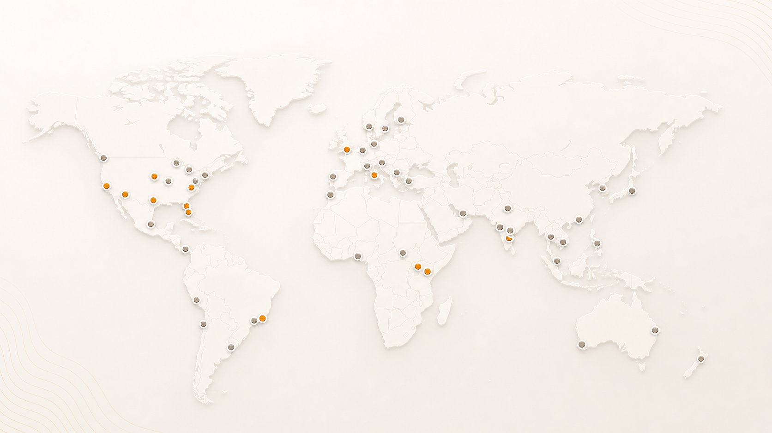
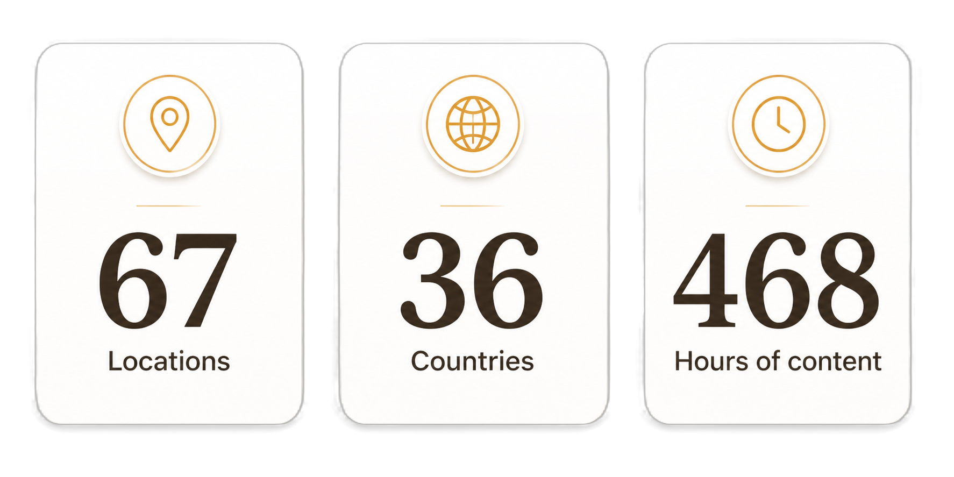
AgentCon around the world

Slide 3
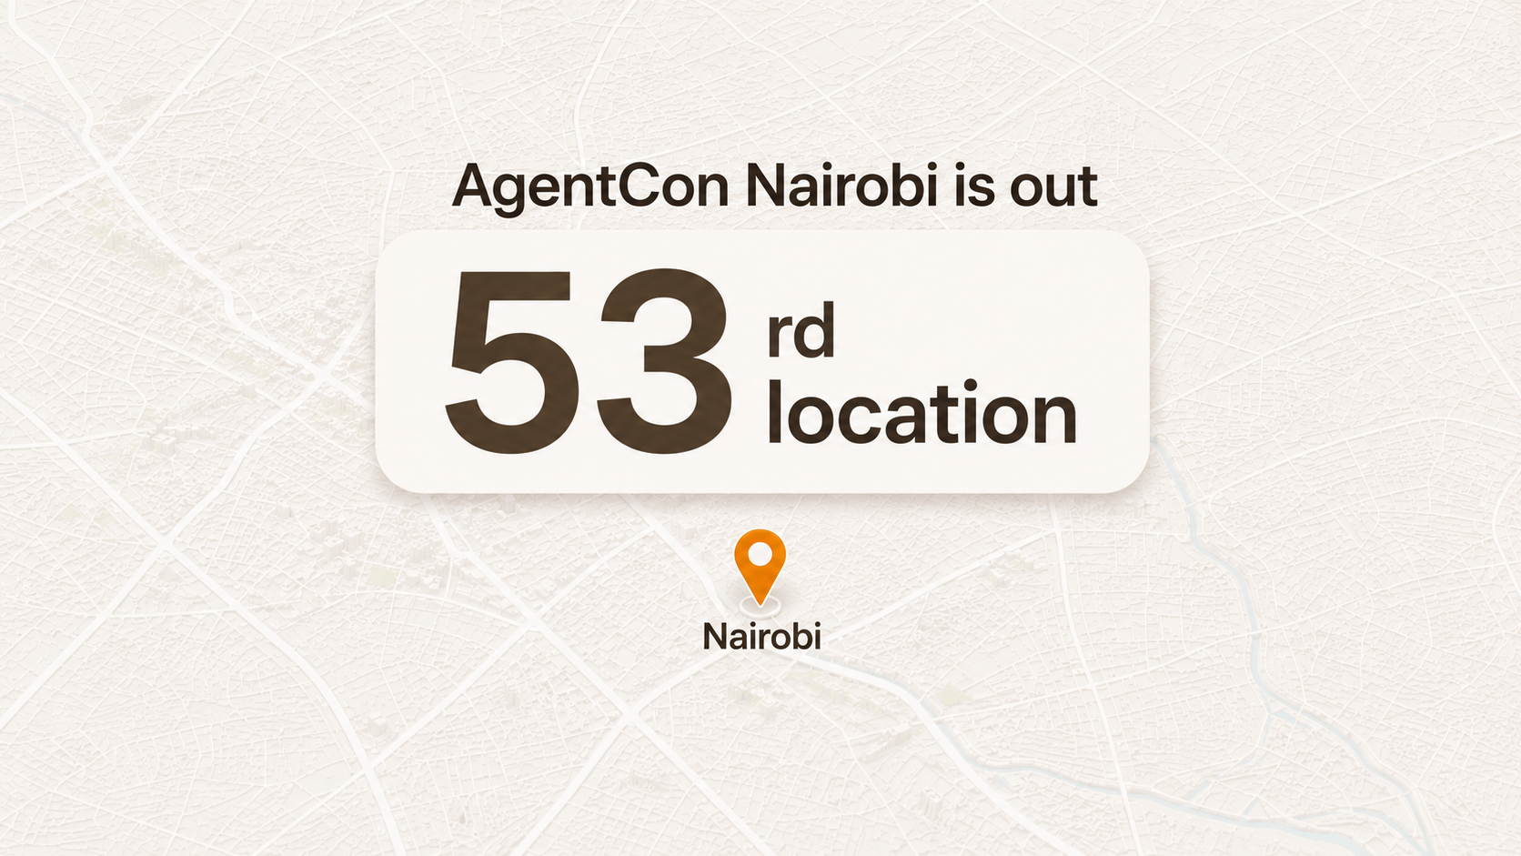

Slide 4
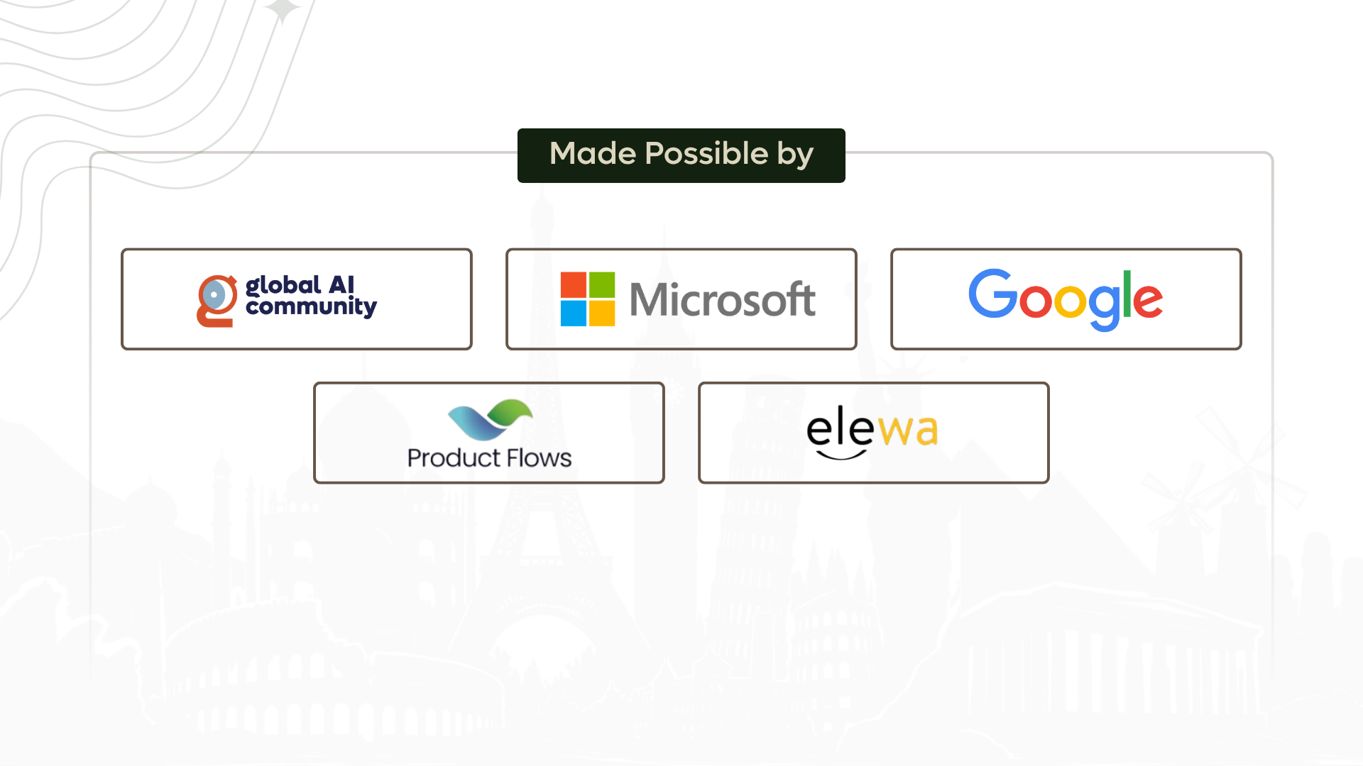

Slide 5
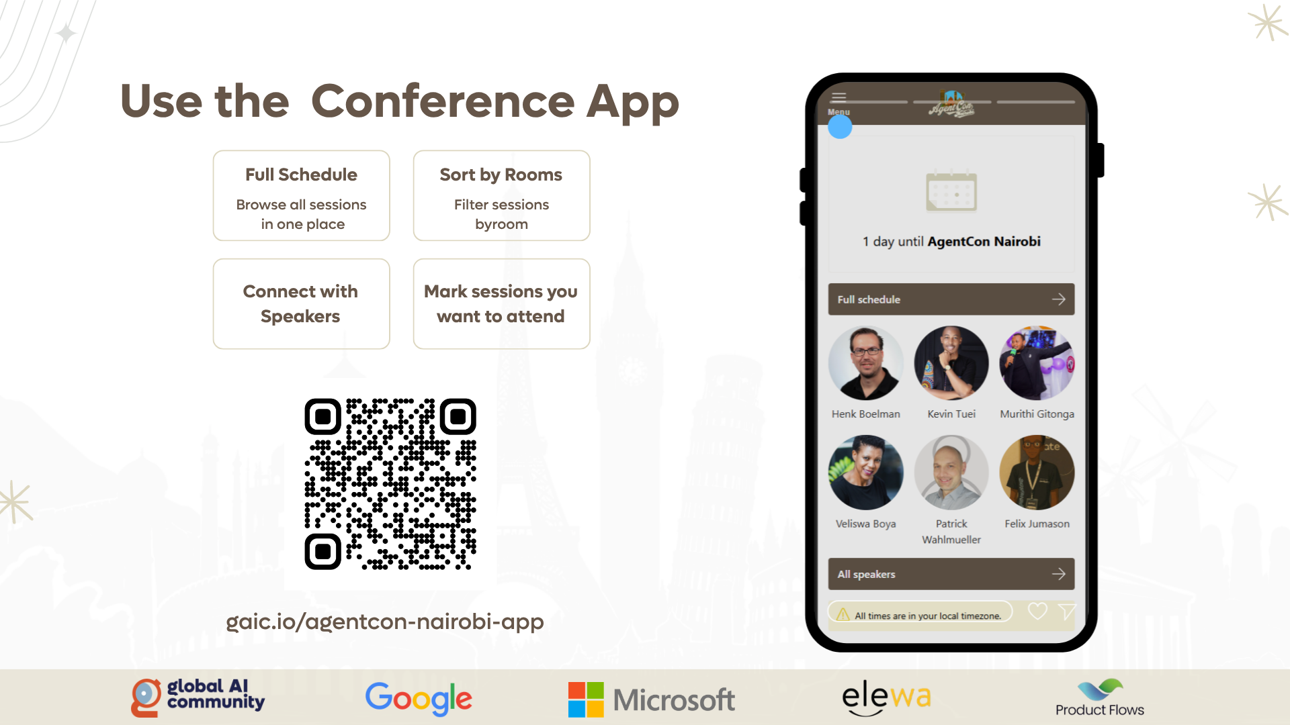

Slide 6
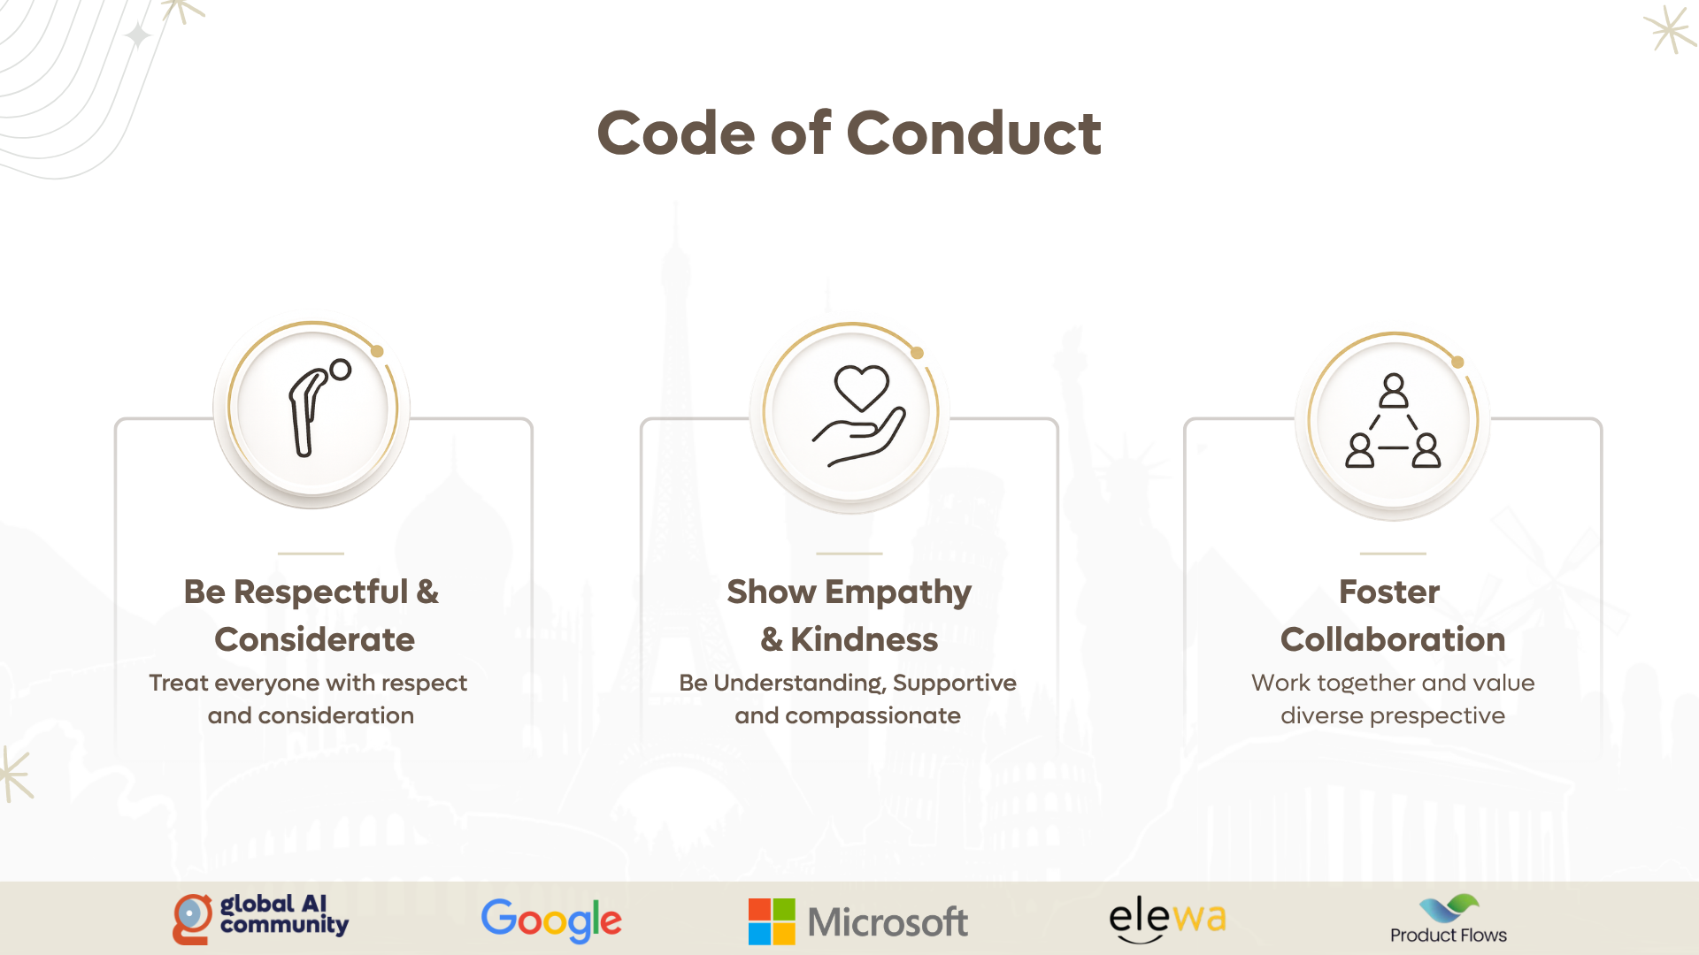

Slide 7
09:15 AM
09:30 AM
Welcome Note
09:30 AM
10:20 AM
Keynote
Henk Boelman
THEATER
WORKSHOP SPACE
10:30 AM – 12:25 PM
Sessions
10:30 AM – 11:55 PM
Workshop
12:30 PM – 01:30 PM
Lunch
01:30 PM – 02:55 PM
Sessions
01:30 PM – 03:00 PM
Workshop
03:00 PM – 03:15 PM
Break
03:15 PM – 04:40 PM
Sessions
03:15 PM – 04:45 PM
Workshop
04:45 PM
The Grand Closing: Raffle & Community Quiz

Slide 8

Join the AI Conversation on Discord
gaic.io/discord

Slide 9
Your feedback matters
Add feedback QR code here

